Slide 1
Chapter 6 Part 3
Data Types

Slide 2
Chapter 6 Topics
Union Types
Pointer and Reference Types
Type Checking
Strong Typing
Type Equivalence
Theory and Data Types

Slide 3
Unions Types
A union
A type whose variables can store values of different types at different times during execution
However, a union only has one value at a time
What could a union be used for?
Design issues
Should type checking be required?
Should unions be embedded in records?

Slide 4
Discriminated vs. Free Unions
In Fortran, C, and C++
Unions have no support for type checking
These unions are called free unions
Up to the programmer to keep track of which type is stored
Example in C
union flexType {
int intEl;
float floatEl;
};
union flexType u1;
u1.intEl = 12;
u1.floatEl = 22.8;
float x = u1.floatEl;
int y = u1.intEl;
Retrieving integer when a float is stored Legal, but produces garbage
Float bits are simply stored in int variable

Slide 5
Discriminated vs. Free Unions
Type checking of unions
Supported by Ada, ML, Haskell, and F#
Note that this isn’t covered in the textbook
Require that each union include a type indicator called a discriminant or a tag
The discriminant is used to check the type of a union, and detect errors if invalid fields are accessed

Slide 6
Ada Union Types
Example of a discriminated union
A Figure union stores circle, triangle, or rectangle data
The discriminant is Form
Its value can be Circle, Triangle, or Rectangle
Only appropriate data can be stored, based on value of Form
type Shape is (Circle, Triangle, Rectangle);
type Colors is (Red, Green, Blue);
type Figure (Form: Shape) is record
Filled: Boolean;
Color: Colors;
case Form is
when Circle => Diameter: Float;
when Triangle =>
Leftside, Rightside: Integer;
Angle: Float;
when Rectangle => Side1, Side2: Integer;
end case;
end record;
Notes:
Notice that Ada uses a record to represent a union.
In this example, Shape and Colors are enumerations. The fields of the Figure record are Filled, Color, and Form. There are additional fields depending on the value of the Color field. If the value of Color is Circle, there is only one additional field, namely Diameter. If the value of Color is Triangle, there are three additional fields, namely Leftside, Rightside, and Angle. Finally, If the value of Color is Rectangle, there are two additional fields, namely Side1 and Side2.
Note that the types of the additional fields vary (some are integers, while others are floating point values), and that storage for these fields will be allocated from the same space in memory (although only the fields appropriate for Circle, Triangle, or Rectangle will be allocated).

Slide 7
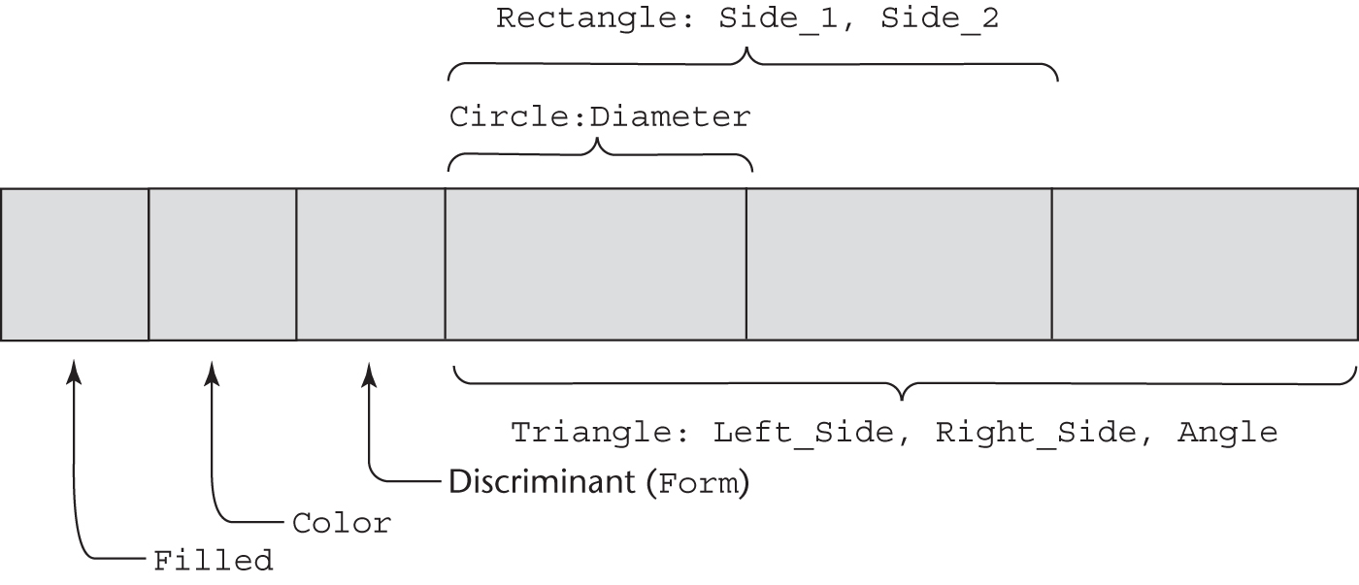
Ada Union Type Illustrated
The discriminated union example in memory
Example of how a Figure variable is declared
F_1 : Figure;
F_1 := (Filled => True, Color => Blue, Form => Circle, Diameter => 1.3);
Note that Side_1, Side_2, Left_side, Right_side, and angle can’t be set because Form is set to Circle

Slide 8
Evaluation of Unions
Free unions are unsafe
Do not allow type checking
Java and C# do not support unions
Reflects growing concerns for safety
Ada’s discriminated unions are safe
Notes:
Can you identify a drawback associated with discriminated unions?

Slide 9
Pointer and Reference Types
A pointer type variable
Values are memory addresses that reference a memory cell
Special value, nil, means it doesn’t refer to a memory cell
Two possible uses of pointers
Provide the power of indirect addressing
A means of referring to a variable via a different name
Provide a way to manage dynamic memory
A pointer can be used to access a location in the area where storage is dynamically created (the heap)

Slide 10
Design Issues of Pointers
What are the scope & lifetime of a pointer variable?
Note: Not the scope and lifetime of the referenced value
What is the lifetime of a heap-dynamic variable?
Relevant if pointers used for dynamic memory management
Are pointers restricted as to the type of value to which they can point?
Are pointers used for dynamic storage management, indirect addressing, or both?
Should the language support pointer types, reference types, or both?

Slide 11
Pointer Operations
Two fundamental operations for pointers
Assignment
Sets a pointer variable’s value to an address
If variable isn’t on heap, needs a way to get a variable address
For example, in C++ this sets p to the address of val
int *p = &val;
Dereferencing
Yields the value stored at the location represented by the pointer’s value
Can be explicit or implicit
C++ has explicit dereferencing via the * operator
j = *ptr;
Sets j to the value located at memory address stored in ptr
Implicit pointers are automatically dereferenced when used

Slide 12
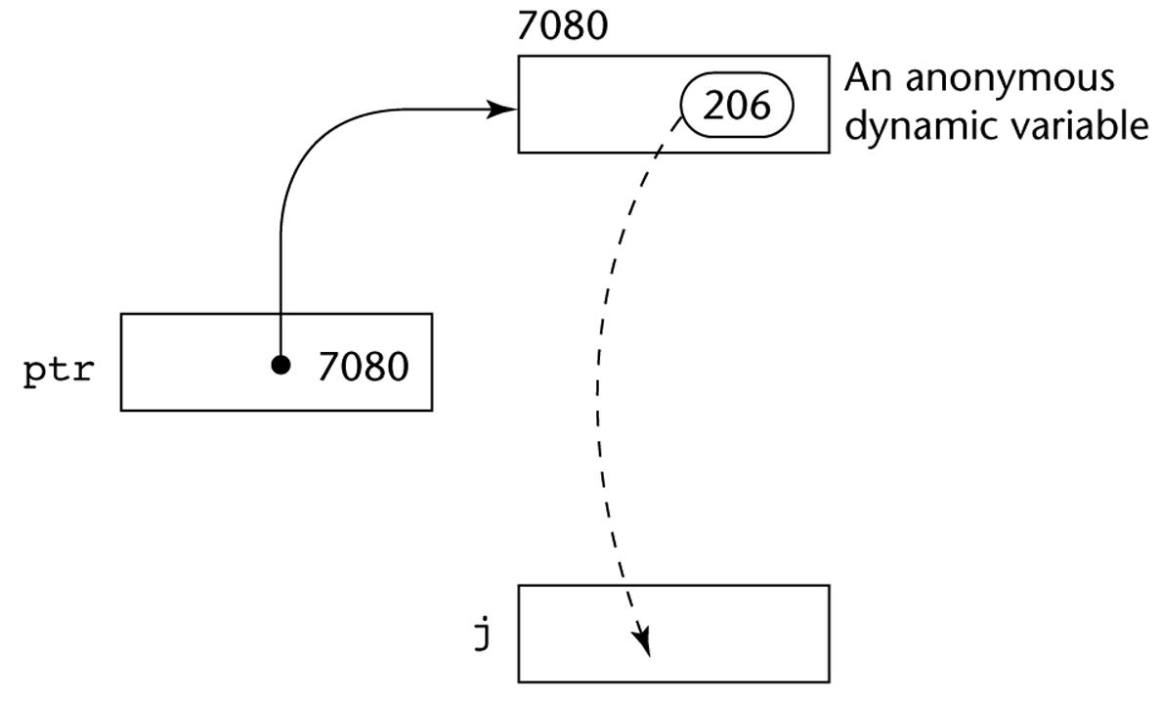
Pointer Dereferencing Illustrated
In C++
Assume that ptr stores memory address 7080
The value 206 is stored at memory address 7080
The assignment j = *ptr
Dereferences ptr to get the value it’s pointing to (i.e. 206)
Copies this value and assigns it to the variable j

Slide 13
Problems with Pointers
Dangling pointers
A pointer to a deallocated heap-dynamic variable
Dangerous (why?)
Lost heap-dynamic variable
An allocated heap-dynamic variable that is no longer accessible to the user program (often called garbage)
For example
Pointer p1 is set to point to a newly created heap-dynamic variable
Pointer p1 is later set to point to another newly created heap-dynamic variable (without first deallocating p1)
The process is called memory leakage
p1:

Slide 14
Pointers in C and C++
Extremely flexible but must be used with care
Pointers can point at any variable regardless of when or where it was allocated
For dynamic storage management and addressing
Pointer arithmetic is possible
Explicit dereferencing and address-of operators
Domain type need not be fixed
A void* can point to value of any type
Cannot be de-referenced unless converted to another type
How does this affect type checking?
Notes:
Here’s an example of a void pointer in C++:
int value = 5;
void *voidPtr = &value;
//cout << *voidPtr << endl; // this is illegal
int *intPtr = static_cast<int*>(voidPtr); // here we cast the void pointer to an int pointer
cout << *intPtr << endl; // dereferencing the cast pointer is legal
It is possible to cast a void pointer to a pointer for an incorrect type. For example, the previous example could have performed a static cast to a float*, and assigned the result to the variable float *floatPtr. In this case, the compiler will accept the cast, but the value pointed to will be garbage. Therefore, dereferencing floatPtr will produce a value unrelated to 5.
Also note that pointer arithmetic is not allowed on void pointers. Why is this the case?

Slide 15
Pointers in C and C++
Example of dynamic storage management in C++
Dynamic storage allocation uses new
int *p = new int[10];
Here p points to newly allocated heap memory
To deallocate heap memory pointed to by p
delete[] p;
C uses functions
malloc to allocate heap memory
free to deallocate heap memory

Slide 16
Pointers in C and C++
Pointer arithmetic
Following code sets p to the address of first value in stuff
float stuff[100];
float *p;
p = stuff;
The pointer p can now be used as another name for stuff
*(p + 5) is equivalent to stuff[5] and p[5]
*(p + i) is equivalent to stuff[i] and p[i]
In this example p + 5 adds 5 float memory offsets to p, giving the memory address of the sixth float in stuff

Slide 17
Reference Types
C++ includes a reference type
References are similar to pointers
In this example ref is a reference to v
int v = 10;
int &ref = v;
Used primarily for formal parameters, giving benefits of pass-by reference and pass-by-value
void f(int &p) { ... }
int val = 12;
f(val);
Here p is a reference to a parameter, works like an int variable, but doesn’t need to be dereferenced like a pointer
No pointer arithmetic is allowed, thus safer than pointers

Slide 18
Reference Types
Java extends C++ reference variables
Allows them to replace pointers entirely
References can refer only to objects, not primitives
How does this support affect language evaluation criteria?
C# includes both pointers and references
References are similar to those in Java
C++ pointers (but only in subprograms marked as unsafe)
How does this affect the language evaluation criteria?

Slide 19
Evaluation of Pointers
Problems
Dangling pointers and lost heap-dynamic variables
If pointers are used for dynamic storage management
Manual heap management is necessary
Effect on language evaluation criteria?
Pointers are like the goto statement
Widen the range of cells accessible by a variable
Dynamic data structures (e.g. a linked list)
Require pointers or references
So we can't completely avoid them

Slide 20
Type Checking
For this section, we generalize operands and operators to include subprograms and assignments
For subprogram call f(1.2), operator is f, operand is 1.2
For assignment a = 43, operator is =, operands are a & 43
Type checking is the activity of ensuring that the operands of an operator are of compatible types
A compatible type is one that is either
Legal for the operator
Or is allowed under language rules to be implicitly converted, by the compiler, to a legal type (coercion)
A type error
Application of operator to an operand of inappropriate type

Slide 21
Type Checking (continued)
If all type bindings are static
Nearly all type checking can be static
Why is this the case?
If type bindings are dynamic
Type checking must be dynamic
Why is this the case?
Strongly typed programming language
Type errors are always detected
Advantage
Detects all variable misuses causing type errors
Usually the strength of typing is relative
“Language A is more strongly typed than language B”

Slide 22
Strong Typing
Language examples
C and C++ are not strongly typed
In pre-C99 parameter type checking can be avoided
Both include unions, which are not type checked
Can you think of other reasons C or C++ aren’t strongly typed?
Java and C#
Implicit type errors cannot go undetected
But explicit casting can result in type errors
Therefore more strongly typed than C and C++
ML and F# are very strongly typed
Notes:
Explicit casting in Java can lead to type errors. For example, assume the class Child inherits from the class Parent. The following will compile in Java:
Child obj = (Child) new Parent();
However, a runtime error will occur. Here the programmer is performing an explicit cast, which the compiler will accept because an object reference to a Parent could be an instance of class Child. Only at runtime does the JVM determine that the Parent object reference is not actually a Child object.

Slide 23
Strong Typing (continued)
Coercion rules can weaken typing
Coercion automatically converts operands to same type
Can cause accidental type mismatches go undetected
For example, if a and b are int variables and d is a float
You mean to add a and b, but mistype b as d
Compiler/interpreter converts a to a float
Mistyping error isn’t detected
Language examples
C++ has many coercions, thus is less reliable
Ada has very little coercion
Java has half of C++ assignment coercions but is still less strongly typed than Ada

Slide 24
Type Equivalence
Defines when operands of two types can be substitutable, with no coercion
Defines types of operands acceptable for all operators
For predefined scalar types
Simple and rigid (usually a type is only equivalent to itself)
For structured types and some user-defined types
Type equivalence rules are more complex

Slide 25
Name Type Equivalence
Name type equivalence
Two variables have equivalent types if both are either
In the same declaration, or
In declarations that use the same type name
Easy to implement but highly restrictive
For example
User-defined ordinal types are not equivalent to integer types and vice-versa
Formal parameters must be the same type as their corresponding actual parameters

Slide 26
Structure Type Equivalence
Structure type equivalence
Two variables have equivalent types if their types have identical structures
More flexible, but harder to implement

Slide 27
Structure Type Equivalence
Consider the problem of two structured types
Are two record types equivalent if their fields are the same, but use different field names?
Are two array types equivalent if they are the same except that their base subscripts differ?
For example, are int arr1[1..10] and int arr2[0..9] type equivalent?
Are two enumeration types equivalent if they differ only in the names of their constants?
With structural type equivalence, compiler/interpreter cannot differentiate between types with same structure
A float value representing miles per hour and another float value representing kilometers per hour
Only the programmer can tell them apart
Notes:
How could you solve the problem described under the last point?

Slide 28
Theory and Data Types
Type theory is a broad area of study in
Mathematics
Logic
Computer science
Philosophy
Two branches of type theory:
Practical: Concerns data types in commercial languages
Abstract: Often concerns typed lambda calculus and of interest only to theoretical computer scientists
A type system
A set of types
The rules that govern type use in programs

